Slide 1

Engineering Problem and Goal
The Problem
The Engineering Goal
Industries often lack real-time, centralised insight into their energy usage. This stems from:
To develop a real-time, IoT-based energy monitoring system that:
Manual monitoring systems.
Fragmented data collection.
End of the month electricity bills
Leading to Energy waste.
Collects and visualises energy data on a single platform.
Enables informed decisions for improved energy efficiency.
Promotes a sustainable future.
Provides backbone for future carbon trading

Slide 2

Current Limitations and
its Proposed Solution
Existing Approaches
Manual energy audits
Standalone energy meters
SCADA based energy management systems
Problems with Current Systems
Expensive or fragmented
Dashboards primarily focus on solar energy data
Neglect comprehensive carbon footprint tracking
Our Proposed Solution: AieX
IoT-based monitoring using Raspberry Pi and ESP32
Enables real-time energy tracking
Creates a low-cost, centralised monitoring system

Slide 3
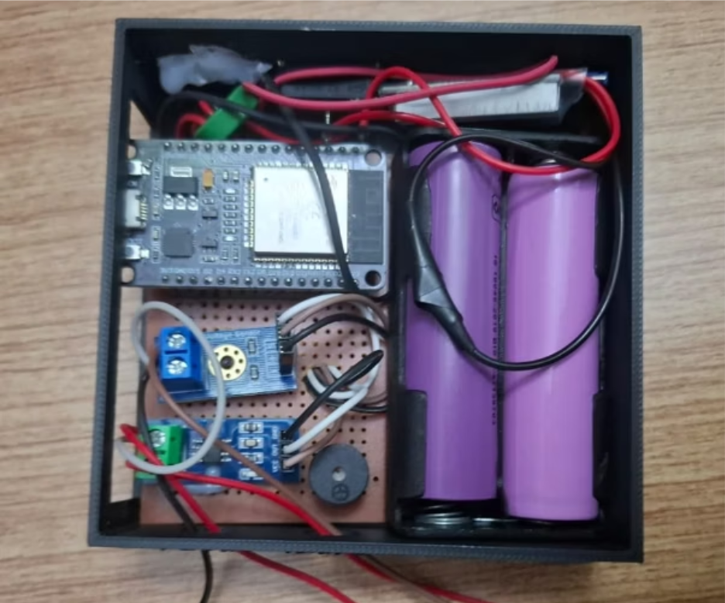

Methods and Procedures: Building AieX
System Design & Prototype
Developed an IoT energy monitoring system
Prototype built in two key parts:
  ESP32-based Energy Logger: Measures voltage and current, uploads data wirelessly
  Raspberry Pi–based Gateway: Collects data from
  industrial meters via Modbus, processes it, and displays on a live dashboard
Assembly & Integration
Utilised a combination of sensors and microcontrollers
Implemented MQTT communication protocols for data transfer
Designed for continuous energy monitoring

Slide 4
AieX Architecture
Edge Devices
Energy Meters
Solar Inverter
Edge Gateway
Raspberry Pi
Data Ingestion & Processing
Insights
Grafana Dashboards (Real time inference)
Alerts (Anomaly detection)
Diesel Generator
Loads
Sensors (Temperature / Solar Irradiance)
Modbus
Mosquito MQTT (Message Queuing Telemetry Transport)
Telegraf (Time Stamp)
Influx (Database)
Predictive Analytics (Machine Learning) / Forecasting
(Under Development)
Packet Hashing (for Data immutability)
Audit
HyperLedger (Blockchain) (Under Development)
Energy Insights (kW, kWh Power Factor
Carbon (CO2 Avoidance, CO2 Emission)

Slide 5
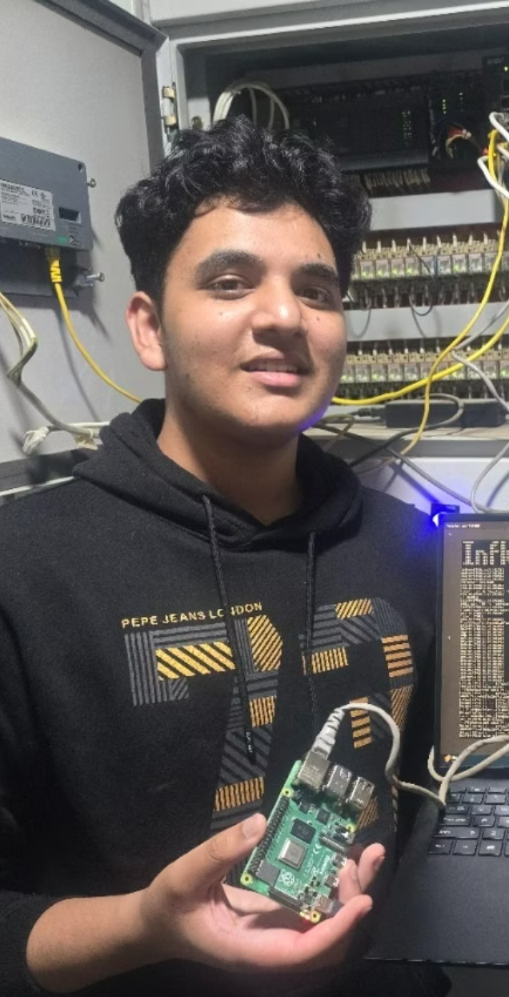
Testing AieX in a Real-World Environment
On-site Implementation
Prototype deployed at the TerraTech office.
Connected to active electrical loads and energy meters
Ensured testing under realistic conditions
Data Collection & Analysis
Real-time voltage, current, and energy data collected
Data transmitted via MQTT to the central dashboard
Time-series visualisations used for performance and reliability evaluation.

Slide 6
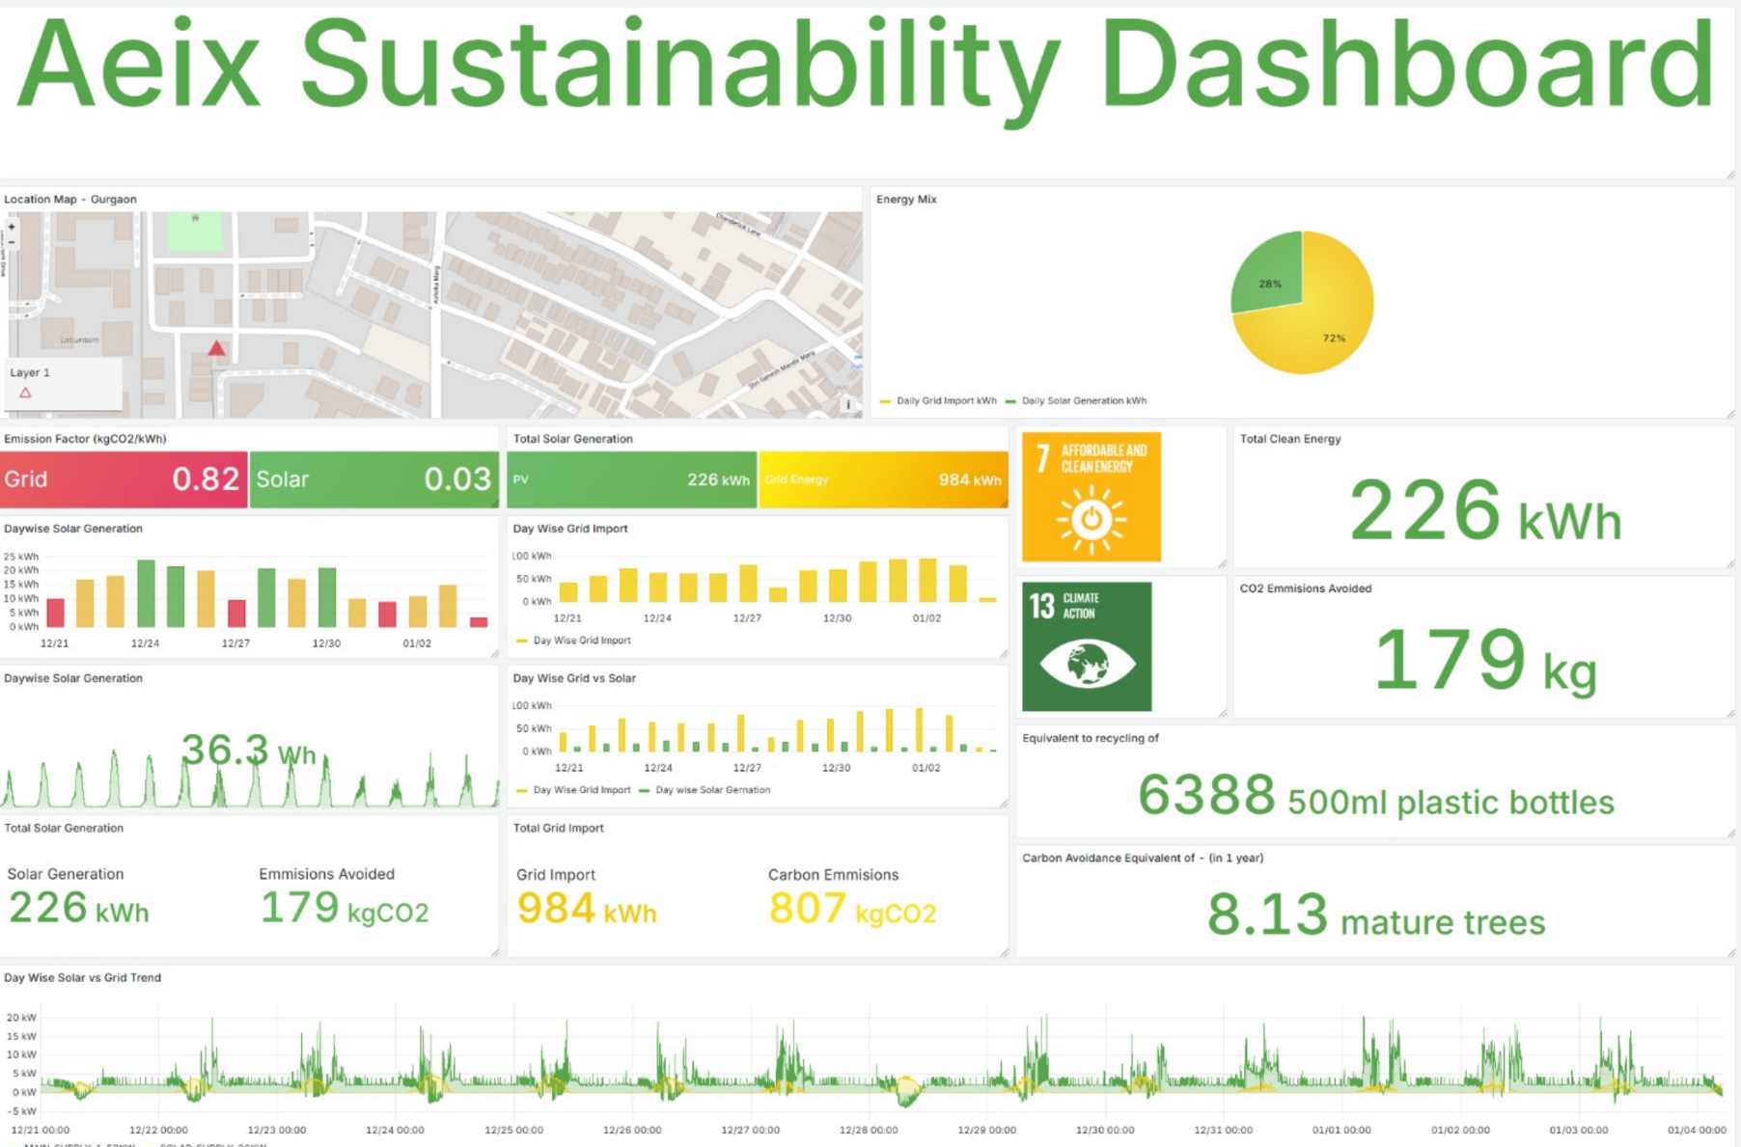

Slide 7
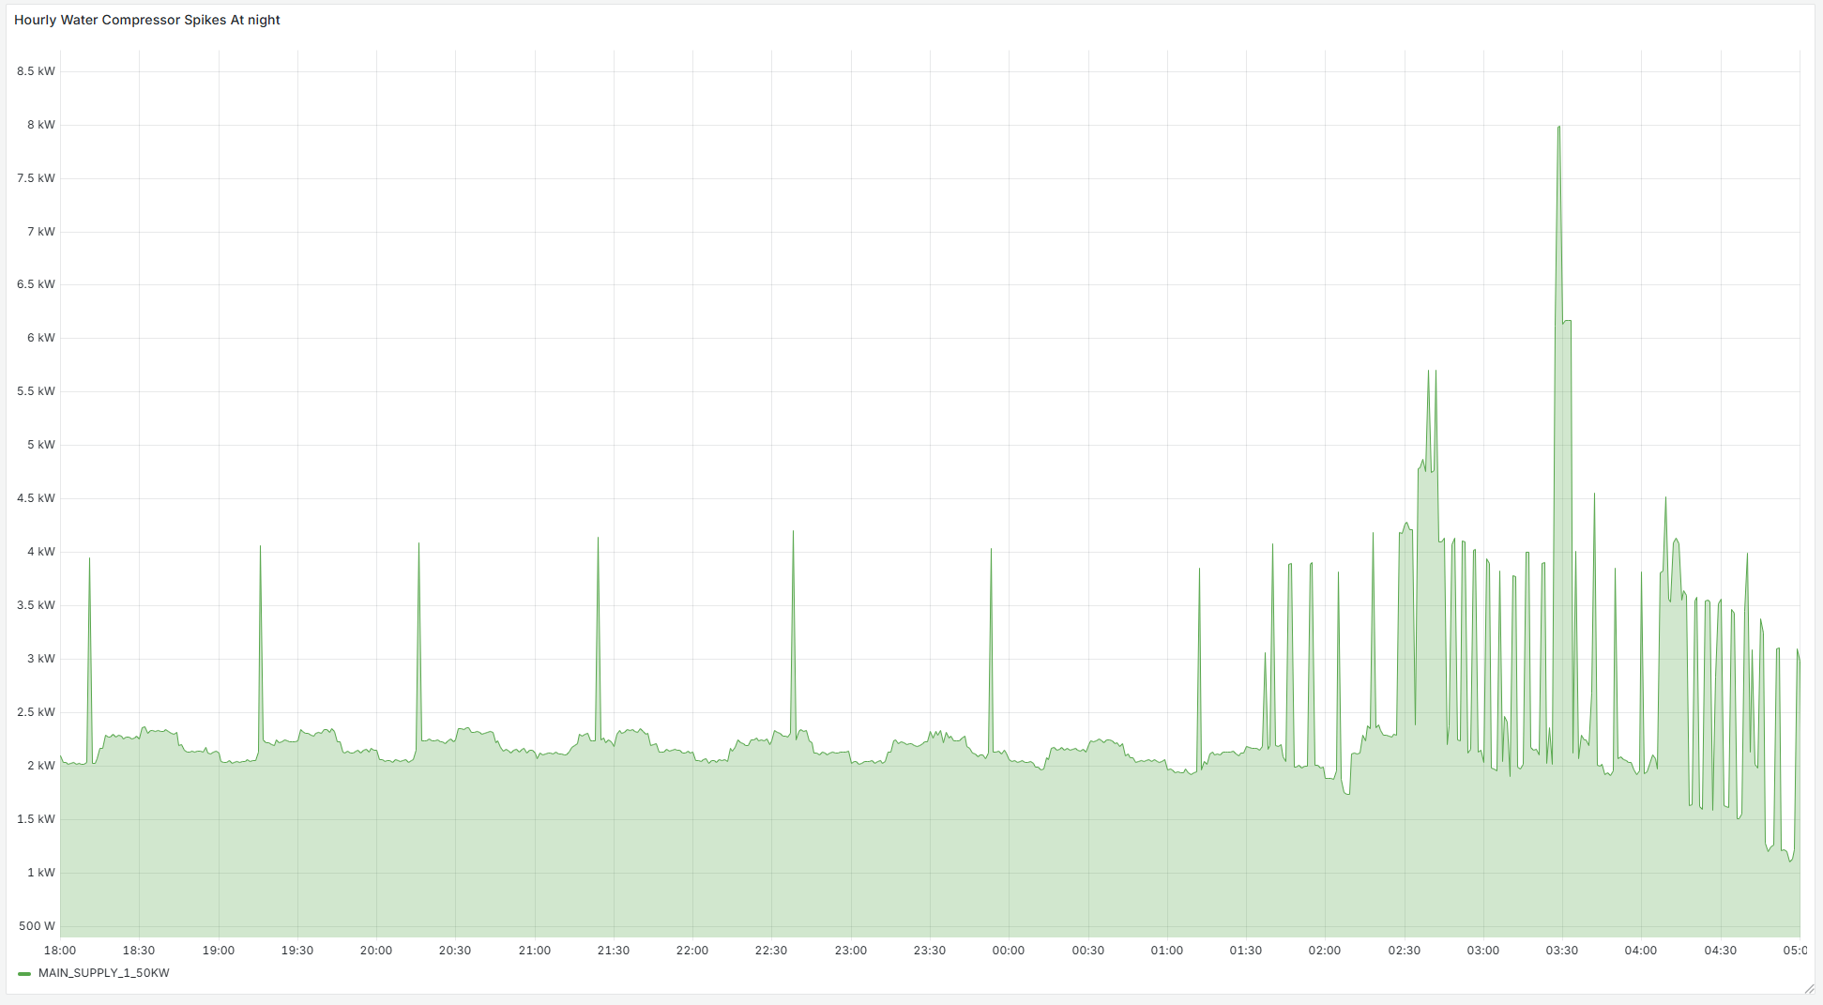
Impact – Ghost Loads
Identification of Ghost Loads

Slide 8
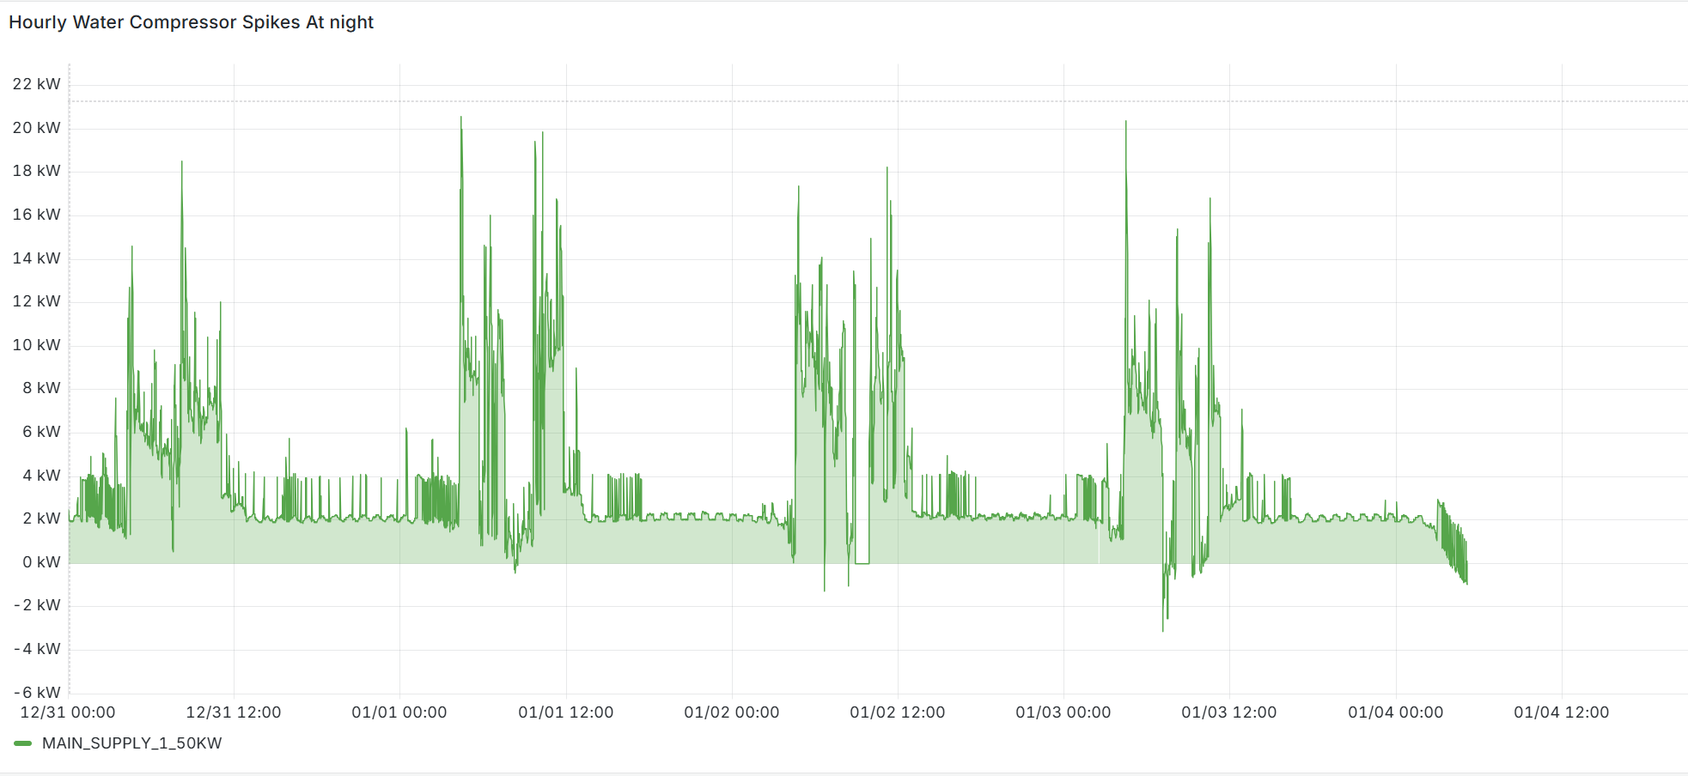
Impact – Ghost Loads
Identification of Ghost Loads
and its removal

Slide 10
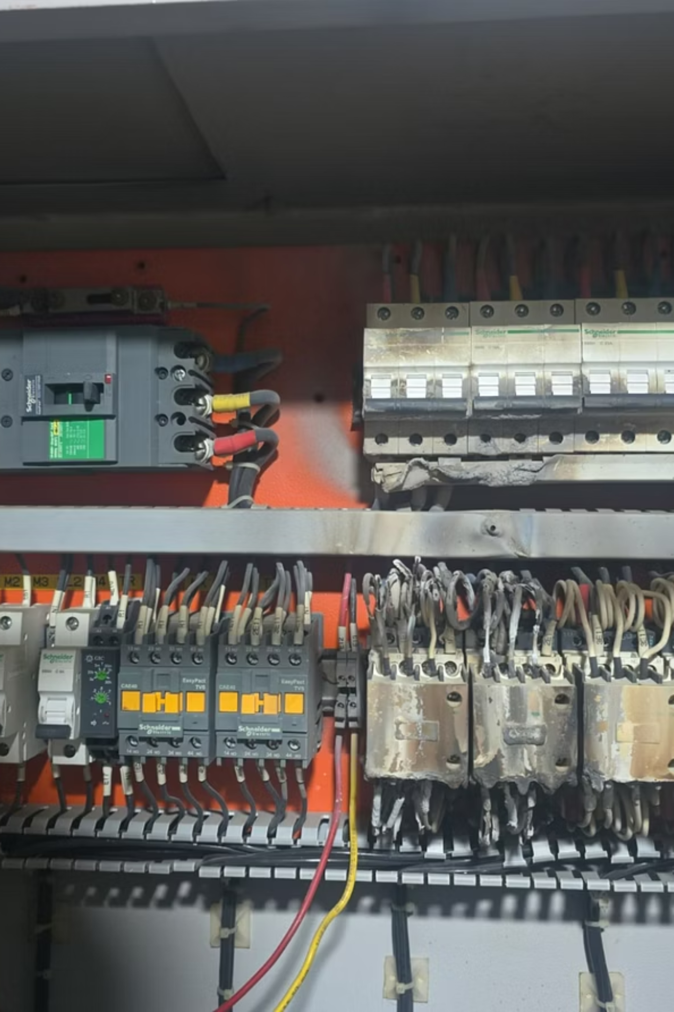
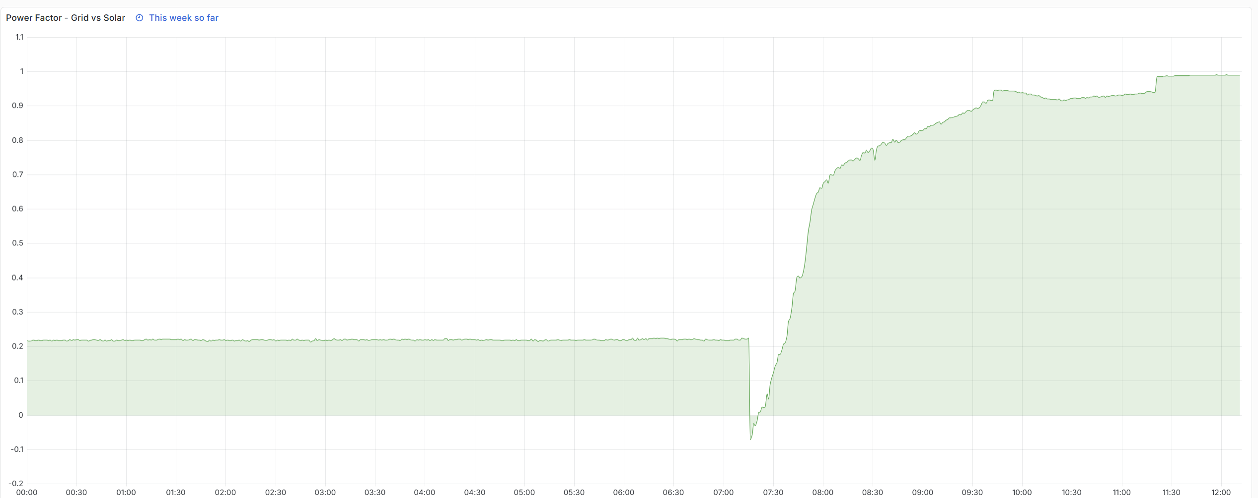
Impact – Capacitor Panel (Power Factor)
Before
After
Improvement of Power Factor

Slide 11
Night Consumption
 | 18:00 | 04:00 | 10 hours
Before AieX | 2 kWh x 10 hr |  | 20 | kWh
Air Compressor Peak
No of Peaks | 9
 | 2 kWh x 5 min x 9 |  | 1.5 | kWh
Total Night Consumption |  |  | 21.5 | kWh
After AieX | 2 kWh x 10 hr |  | 20 | kWh
Night Savings |  |  | 1.5 | kWh
 |  |  | 7.5% | savings
SDG 12 Savings |  |  | Rs/ Unit
Monthly Saving on Night Consumption | 45 | kWh | 10 | ₹ 450
Yearly Saving | 547.5 | kWh | 10 | ₹ 5,475

Slide 12
Driving Smarter Energy Decisions
1. Enhanced Visibility
Real-time, IoT-based monitoring provides superior visibility and accuracy compared to manual audits.
2. Pattern Discovery
Continuous data collection reveals critical energy usage patterns and peak loads often missed by periodic measurements.
3. Optimization Support
Centralised, real-time monitoring proves more effective for identifying inefficiencies and supporting energy optimisation efforts.

Slide 13
Physical Assets
Energy Meters
Solar Inverter
Edge Gateway
Raspberry Pi
Data Ingestion& Processing
Insights
Grafana Dashboards (Real time inference)
Alerts (Anomaly detection)
Diesel Generator
Loads
Sensors (Temperature / Solar Irradiance)
Modbus
Mosquito MQTT
Telegraf
(Time Stamp)
Influx (Database)
Packet Hashing (for Data immutability)
Energy Insights (kW, kWh Power Factor
Carbon (CO₂ Avoidance, CO₂ Emission)
HyperLedger (Blockchain - Under Development)
Predictive Analytics (ML / Forecasting
(Under Development)

Slide 14
Physical Assets
Energy Meters
Solar Inverter
Edge Gateway
Raspberry Pi
Data Ingestion& Processing
Insights
Grafana Dashboards (Real time inference)
Alerts (Anomaly detection)
Diesel Generator
Loads
Sensors (Temperature / Solar Irradiance)
Modbus
Mosquito MQTT (Message Queuing Telemetry Transport)
Telegraf
(Time Stamp)
Influx (Database)
Predictive Analytics (Machine Learning) / Forecasting
(Under Development)
Packet Hashing (for Data immutability)
Energy Insights (kW, kWh Power Factor
Carbon (CO₂ Avoidance, CO₂ Emission)
Audit
HyperLedger (Blockchain) (Under Development)
Sustainability Reporting for Regulators (Under Development)

Slide 15
TODAY
FUTURE
Energy Management System, Peak Shaving
Smart Cities (Remote Asset Monitoring)
Water & Waste Monitoring
(Flow, level, quality)
Environment (Temperature, Humidity, AQI)
Carbon Calculation Algorithms (Blockchain)
Verifiable Carbon Units for future Carbon Trading
ESG Reporting (Environment, Social, Governance)
Predictive Analytics
(Energy Produced, Energy Consumed)
Anomaly Detection
EU CBAM (Carbon Border Adjustment Mechanism)

Slide 16
Conclusion
This project demonstrates a smart, data-driven energy monitoring framework that integrates IoT, cloud computing, artificial intelligence, and blockchain into a unified system.
Using ESP32-based cloud sensing and Raspberry Pi–Modbus industrial monitoring, it provides a scalable solution for real-time, verifiable energy tracking.
By automating data collection and ensuring integrity through blockchain, the system enables accurate energy and carbon insights, forming a strong foundation for future Energy Management Systems, carbon-credit validation, renewable prioritization, and Net-Zero compliance.

Slide 17
References
Bureau of Energy Efficiency (BEE). (2021). Energy Efficiency in Industry: Policy Framework and Guidelines. Government of India, Ministry of Power.
United Nations. (2023). Net-Zero Coalition: Climate Action for a Sustainable Future. United Nations Climate Action Portal.
Mekhilef, S., Safari, A., & Saidur, R. (2022). Energy consumption, emissions, and climate change: Global perspectives. Journal of Cleaner Production, 378, 134580.
Kumar, S. P., & Prakash, S. (2015). IoT-based energy management systems for industrial applications. International Journal of Advanced Research in Electrical, Electronics and Instrumentation Engineering, 4(7).
Mishra, R., & Soni, A. (2020). AI-enabled energy management systems for industrial optimization. Journal of Cleaner Production, 261, 121220.
Kumar, R., & Shukla, A. (2022). Blockchain and data-driven approaches for national net-zero pathways. Energy Policy, 160, 112678.
Hickel, J. (2019). There Is No Planet B: A Handbook for the Make or Break Years. Penguin Book

