Slide 1
Real Time Industrial Energy Monitoring Using IoT and Edge Computing for Sustainability and Carbon Tracking
Aditya Krishan Goel
Class XI, The Shri Ram School, Aravali,
Gurgaon, HR, India
Sigma Xi Student Research Showcase 2026

Slide 2
The Big Problem
Current State
Consequences
Most industries rely on manual, fragmented systems to monitor energy consumption. Legacy approaches operate in silos, with uncorrelated data from production units, supply chains, and auxiliary systems. Traditional manual monitoring methods are prone to errors, lack real-time capability, and consume significant human effort.
Limited transparency, data inaccuracies, and reporting delays. Industries expend considerable effort compiling outdated data, hindering dynamic response to energy demands or sustainability targets. Without comprehensive and real-time visibility into energy use, it becomes impossible to identify inefficiencies, optimize resource utilization, or make informed decisions that support sustainability commitments.

Slide 3



Research Goal & Hypothesis
Research Question
Primary Goal
Hypothesis
Can IoT monitoring detect inefficiencies in real time?
Design a centralized, intelligent system to collect, process, and visualize real-time energy data across production units, supply systems, and environmental variables to support Net-Zero and sustainability targets.
Yes, with measurable savings. Comprehensive real-time measurement enables targeted actions improving efficiency and reducing emissions. By integrating IoT sensors, edge computing, and cloud-based analytics, energy data can be unified to enable accurate tracking, real-time visualization, predictive analysis, and evidence-based decision-making.

Slide 4
Literature Review: Net-Zero Goals & Sustainability
Net-Zero Goals and Global Sustainability Initiatives
Global Energy Imbalance and Climate Action
Data-Driven Energy Systems and Carbon Verification
United Nations Net-Zero Coalition (2023): Emphasizes achieving net-zero emissions by 2050 through collaborative efforts among governments, industries, and investors. Stresses the importance of transparent and verifiable data on energy use and emissions to ensure accountability in sustainability claims.
Hickel (2019) - "There Is No Planet B": Explores the global imbalance in energy consumption, highlighting the disproportionate contribution of industrialized nations to greenhouse gas emissions. Argues that sustainable development requires both technological innovation and behavioral change, where energy efficiency, renewable integration, and digital transparency become the pillars of climate action.
Kumar and Shukla (2022) - Energy Policy: Analyzes how data-driven energy systems contribute to national Net-Zero pathways. Research concludes that digitized and blockchain-secured energy monitoring platforms can enhance trust in carbon accounting and enable carbon-credit verification, a key component of future sustainable economies.

Slide 5
Literature Review: IoT & Energy Monitoring
Energy Monitoring and IoT-Based Automation
Energy Management Systems (EMS)
Global Standards and Policy
Bureau of Energy Efficiency (BEE): Guidelines promoting standardized energy auditing and management protocols, benchmarking practices, and ISO 50001 compliance for industrial units.
Singh et al. (2018): IoT-based energy monitoring using Raspberry Pi and sensors effectively tracks power usage, production output, and pollution parameters in real time. Traditional manual monitoring methods in Indian industries are prone to errors, lack real-time capability, and consume significant human effort.
IRJET (2016): EMS adoption challenges in India include high upfront costs, limited technical skills, long payback durations, and volatile energy tariffs. Integration of smart IoT systems could significantly lower barriers by automating data collection, visualization, and reporting.
Kumar and Prakash (2015): Arduino and IoT automation applied to smart energy management systems. Framework for integrating multiple energy sources, monitoring parameters via sensors, and automating load control significantly improved energy efficiency and system reliability.
Mishra and Soni (2020): EMS frameworks integrating AI-based optimization and predictive maintenance demonstrated up to 18% improvement in energy efficiency compared to traditional systems.

Slide 6
Research Gap
Traditional EMS Expensive
Existing energy management systems are costly and complex to implement. Current solutions don't adequately serve small and medium enterprises (SMEs), creating barriers to adoption.
Poor SME Fit
Most EMS solutions are designed for large-scale operations and lack affordability for SMEs. Integration challenges and high upfront costs limit accessibility across industries.
No Carbon Visibility
Lack of comprehensive carbon tracking and verification capabilities. Industries cannot easily quantify their carbon footprint or verify sustainability claims without integrated, real-time monitoring systems.

Slide 7
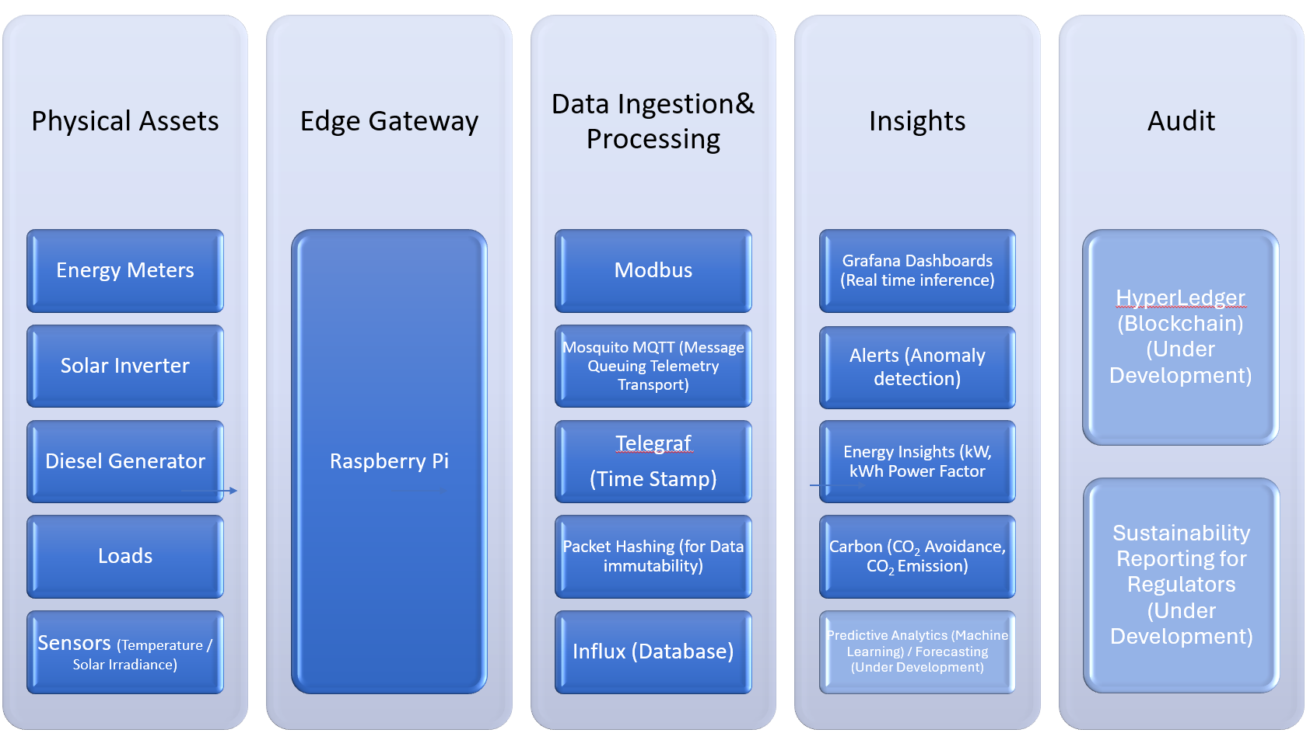
AeiX System Overview

Slide 8
Hardware Architecture
ESP32
Raspberry Pi
Modbus Meters
Low-cost microcontroller for decentralized energy sensing. Uses voltage and current sensors (SCT-013-000 and ZMPT101B) to measure real-time energy parameters and upload readings to cloud servers via Wi-Fi.
Edge gateway running MQTT/Telegraf/InfluxDB for industrial data aggregation. Serves as the central control unit for processing, filtering, and transmitting sensor data from multiple sources.
Industrial digital meters connecting via Modbus RTU protocol for large-scale operational data. Enables integration with existing industrial machines and equipment for comprehensive energy monitoring.

Slide 9
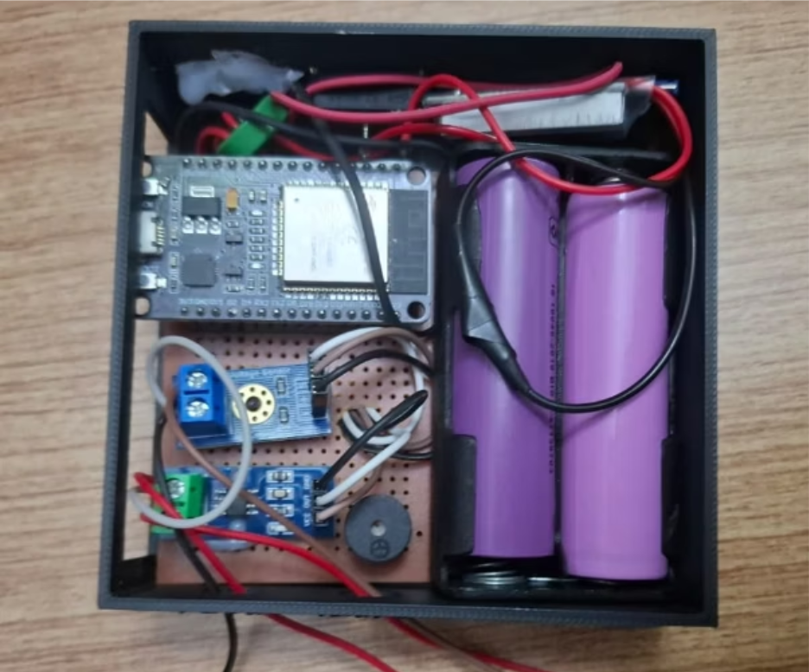

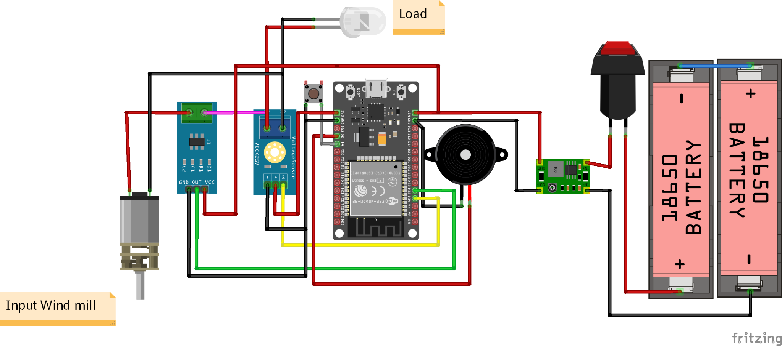
Methodology
Prototype 2: Raspberry Pi Industrial Integration
Prototype 1: ESP32 Energy Data Logger
Uses voltage and current sensors (SCT-013-000 and ZMPT101B) to measure real-time energy parameters
Uploads readings to cloud server through Wi-Fi for live monitoring
Demonstrates low-cost, scalable energy sensing for decentralized collection across multiple sites
5-second sampling
Connects with industrial Modbus devices and digital meters for large-scale operational data
Uses Raspberry Pi as edge gateway running MQTT/Telegraf/InfluxDB for data aggregation and visualization
Implements blockchain encryption (SHA-256 hashing) for secure, traceable, and immutable carbon-credit verification and sustainability audits

Slide 10
Laboratory Prototype
A proof-of-concept energy monitoring node built on IoT hardware, capturing electrical measurements at 5-second sampling intervals with on-device power computation — the first step in validating real-time energy intelligence.
⏱ 5-Second Sampling
⚡ On-Device Power Computation
High-frequency data capture for granular energy visibility
Edge processing via Raspberry Pi / ESP32 nodes for low-latency results
🔬 Validated Sensing
Current and voltage sensors calibrated against reference instruments

Slide 11

Mathematical Model
The system is grounded in three core equations that translate raw electrical signals into actionable sustainability intelligence — from instantaneous power to verified carbon impact.
Instantaneous Power
Energy Consumed
Carbon Emissions
Voltage × Current, sampled every 5 seconds across each monitored load
Cumulative energy calculated by integrating power over time
Energy multiplied by the regional grid emission factor (kg CO₂/kWh)

Slide 12
Dataset & Data Collection
Table 2: Data collection parameters
Parameter | Value
Monitoring duration | 14 days
Sampling interval | 5 seconds
Total data points collected | ~ 240,000
Number of monitored loads | 3
Data storage platform | InfluxDB
Visualization tool | Grafana
Dashboard latency | < 2 seconds
Energy anomaly detection | successful
Energy savings | 7.5%
Continuous streaming from 3 independently monitored loads provided a rich, high-resolution dataset for training analytics models and detecting anomalies.
3 Monitored Load Circuits
Continuous Streaming Pipeline
240,000+ Labeled Records
Production machinery, HVAC, and auxiliary systems independently tracked
Edge nodes push time-stamped readings to cloud storage with no data gaps
Structured dataset enabling anomaly detection and predictive modeling

Slide 13
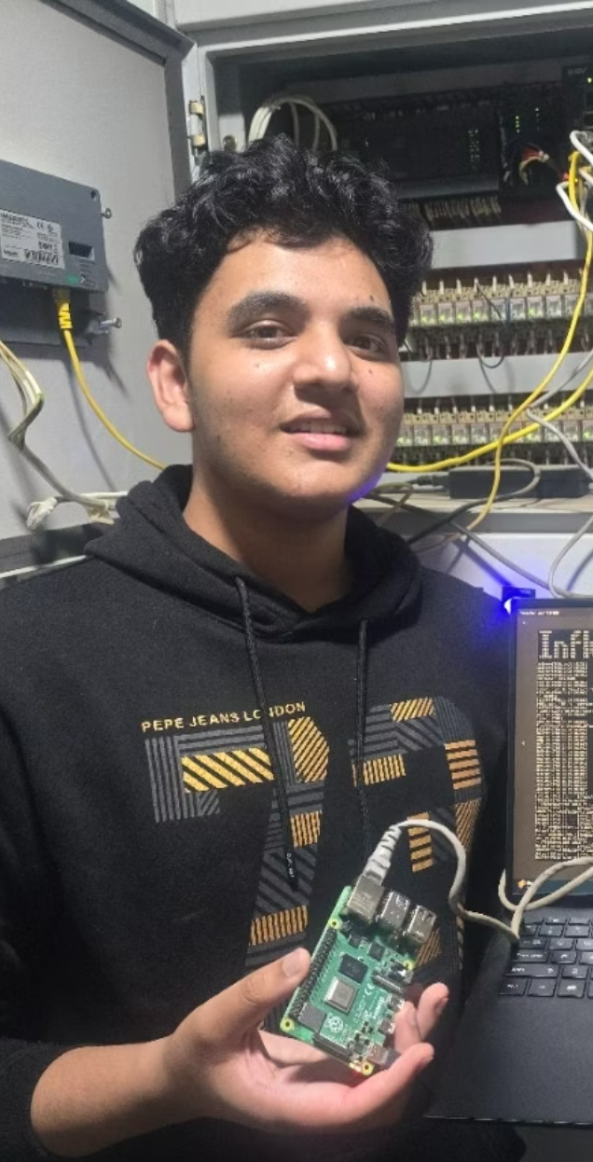
Industrial Pilot Deployment
The prototype scaled to a live industrial environment over a 14-day continuous pilot, stress-testing reliability, latency, and data fidelity under real operational conditions.
14
240K
Days of Deployment
Data Points Captured
Uninterrupted field operation in an active industrial facility
Continuous streaming across all monitored loads
<2s
Latency
Near-real-time data delivery from sensor to dashboard

Slide 14
Comparison with existing energy monitoring system
Feature | Traditional Systems | AeiX System
Monitoring frequency | Monthly | Real-time
Data integration | Manual | Automated
Energy anomaly detection | No | Yes
Carbon emissions estimation | No | Yes
Cost | High | Low

Slide 15
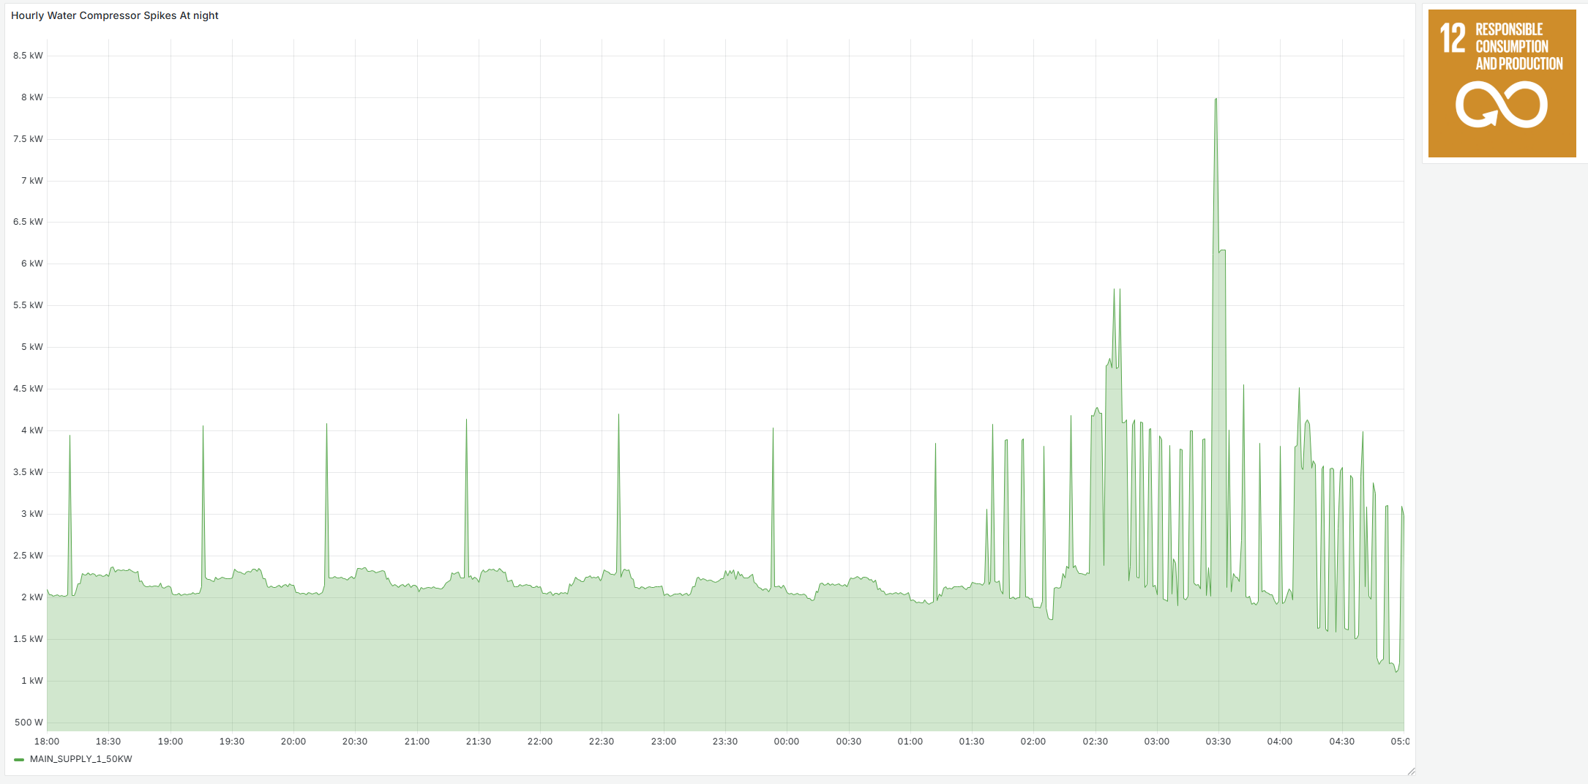
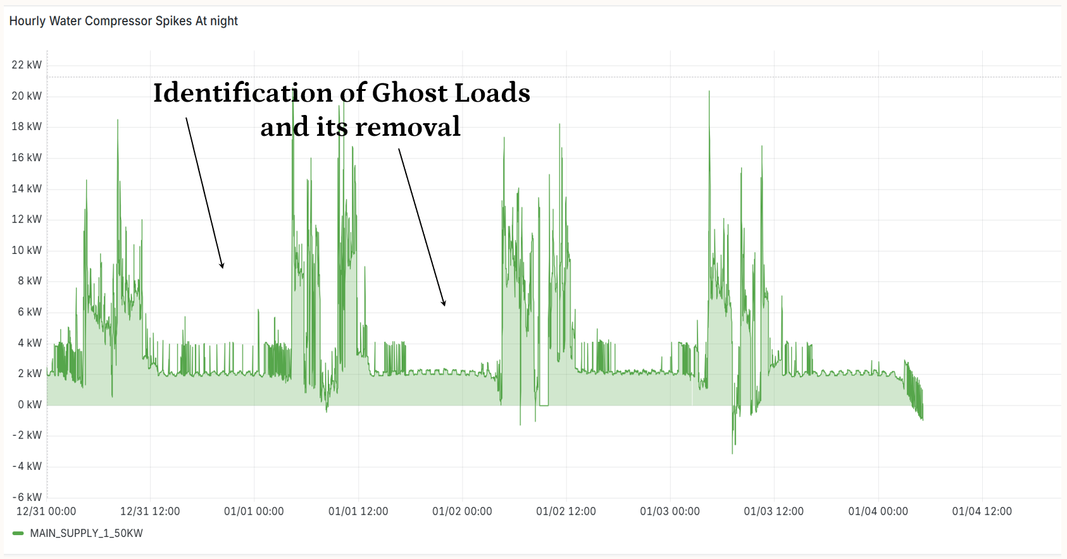
Hidden Ghost Load Detection
Hourly Spikes
One of the most impactful discoveries of the pilot: invisible energy drains operating outside business hours — undetected by legacy systems but clearly exposed by 5-second sampling.
Night Compressor Spikes
Ghost Load Identified
Compressors cycling abnormally after hours, drawing significant unaccounted power
Loads that appear off on manual logs but remain energized — a blind spot in fragmented legacy monitoring
Root Cause Analysis
High-frequency data pinpointed the exact timestamp, circuit, and duration of each anomalous event

Slide 16
Energy Savings Results
7.5% Reduction in Nighttime Energy
Night Consumption
 | 18:00 | 04:00 | 10 hours
Before AieX | 2 kWh x 10 hr |  | 20 | kWh
Air Compressor Peak
No of Peaks | 9
 | 2 kWh x 5 min x 9 |  | 1.5 | kWh
Total Night Consumption |  |  | 21.5 | kWh
After AieX | 2 kWh x 10 hr |  | 20 | kWh
Night Savings |  |  | 1.5 | kWh
 |  |  | 7.5% | savings
SDG 12 Savings |  |  | Rs/ Unit
Monthly Saving on Night Consumption | 45 | kWh | 10 | ₹ 450
Yearly Saving | 547.5 | kWh | 10 | ₹ 5,475
By exposing and eliminating ghost loads — particularly the compressor spikes detected after hours — the system delivered a measurable 7.5% drop in nocturnal energy consumption with no capital equipment changes.
100
This reduction translates directly into lower CO₂ emissions and reduced utility costs, validating the ROI of real-time IoT monitoring even at pilot scale.
92.5
Metric | Before | After
Night Energy Consumption | 21.5 kWh | 20 kWh
Energy Savings | - | 1.5 kWh
Percentage reduction | - | 7.5%

Slide 17
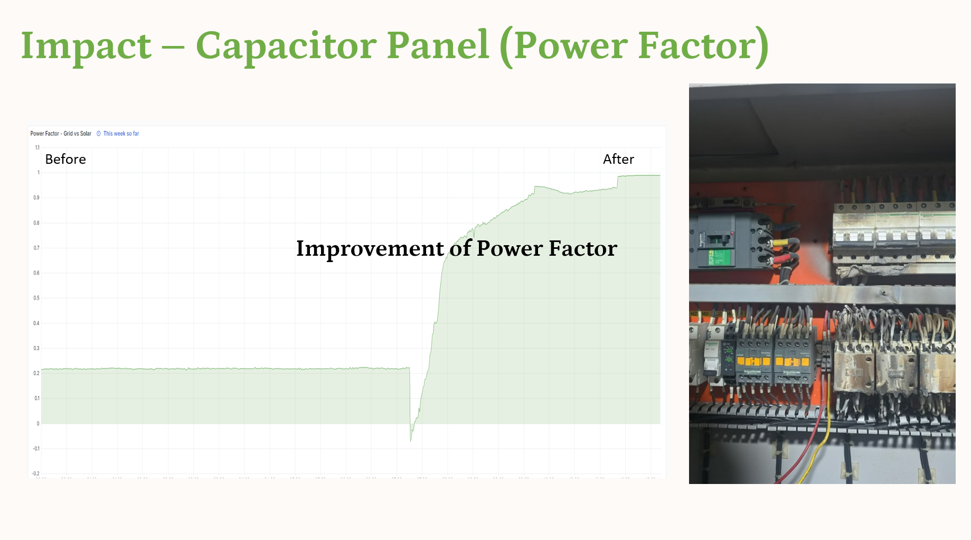
Power Factor Improvement
A dramatic correction in power factor — from a critically low 0.20 to an optimized 0.95 — demonstrates the system's ability to identify reactive power waste and guide corrective action.
0.95
A power factor below 0.85 typically incurs surcharges from utilities. Correcting to 0.95 eliminates penalties and improves system efficiency across the entire facility.
0.2
Before: PF = 0.20
Severe reactive power draw — 80% of apparent power wasted, causing utility penalties and equipment stress
After: PF = 0.95
Near-unity power factor achieved through data-guided capacitor bank adjustments — maximizing real power delivery

Slide 18
Real-Time Sustainability Dashboard
All sensor streams, computed metrics, and carbon KPIs converge into a unified, live analytics dashboard — making energy data transparent, actionable, and audit-ready.
Live Power & Energy
Per-circuit kW and kWh updated every 5 seconds across all monitored loads
Carbon Footprint Tracking
Automated CO₂ calculation using regional emission factors for MRV compliance
Anomaly Alerts
Ghost load spikes and threshold breaches trigger instant notifications for rapid response

Slide 19
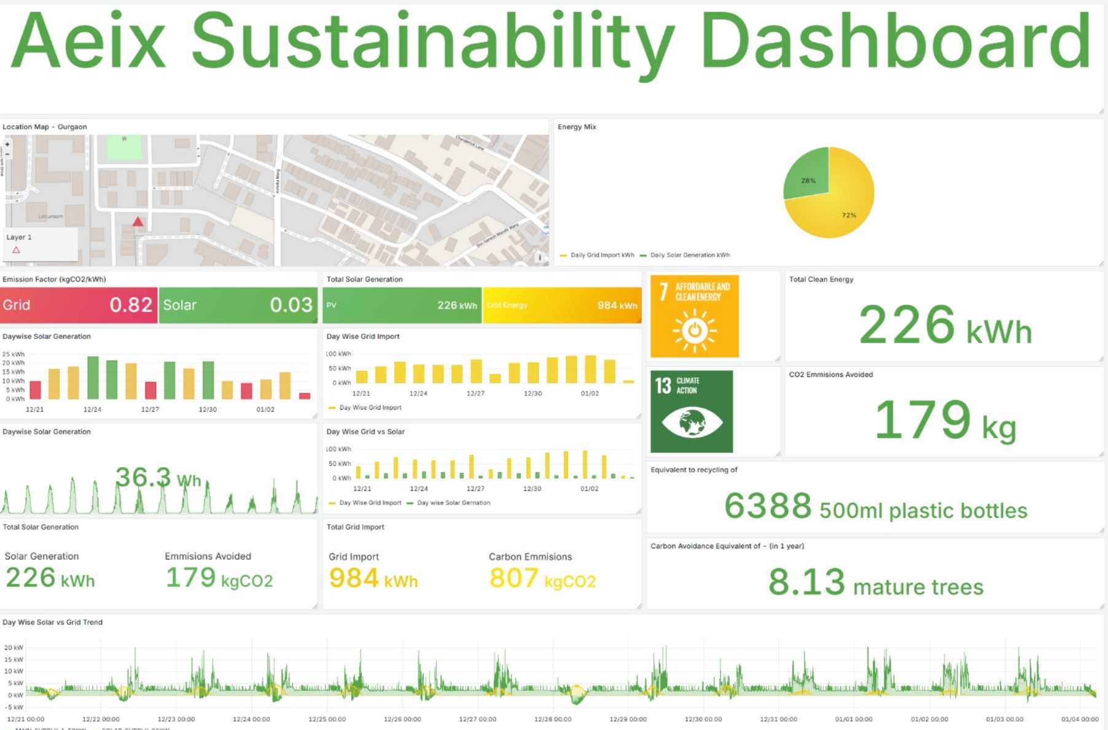

Slide 20
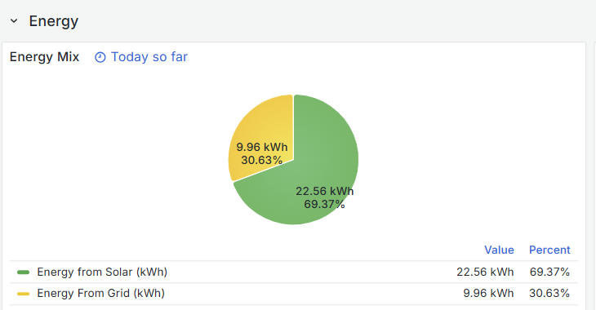

19. Sustainability Impact
Figure 6: Energy From Solar and Grid
CO₂ avoided
SDG 12
Figure 7: Emission Result
Figure 6: Energy From Solar and Grid

Slide 21
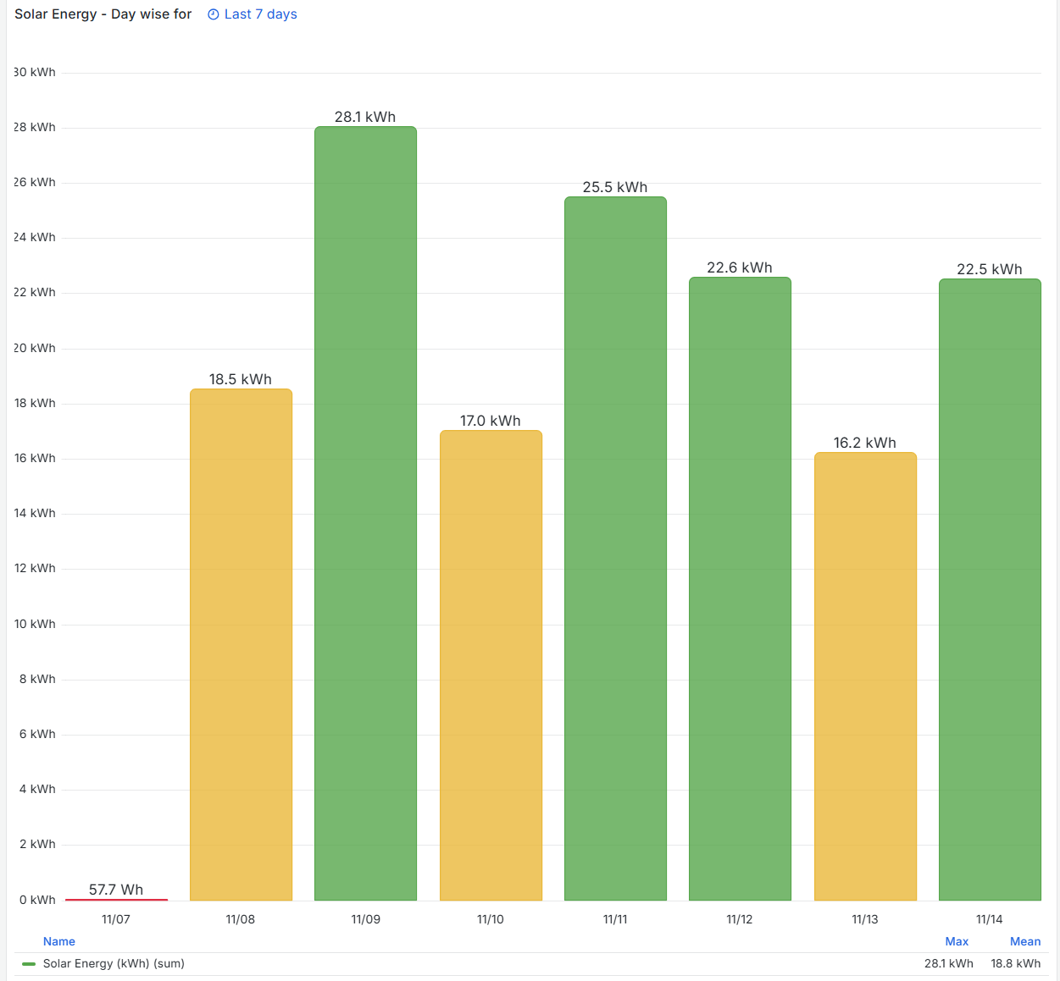
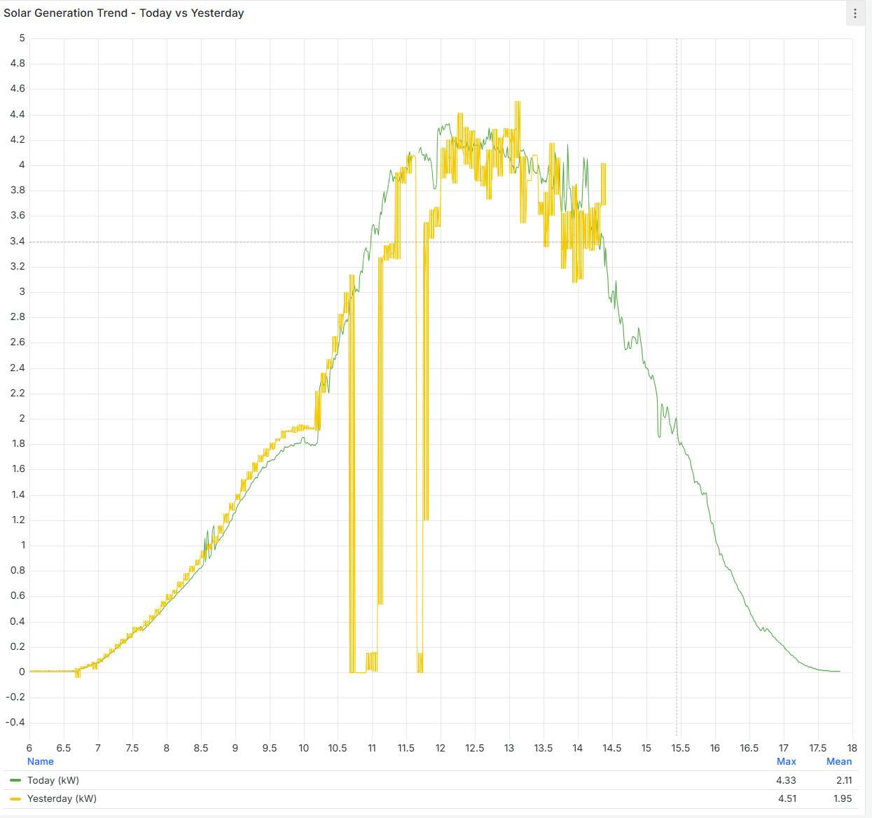
Figure 8: Solar energy Graphs
Figure 9: Solar Generation Trend

Slide 22
Performance Metrics Summary
Across the full 14-day industrial pilot, the AIEX Hybrid EMS delivered on every key performance benchmark — confirming production-grade readiness.
<2s
<2%
End-to-End Latency
Measurement Error
Sensor to dashboard in under 2 seconds, enabling real-time decision-making
Sub-2% deviation validated against certified reference instruments
99%+
240K
System Uptime
Data Points Logged
High reliability over continuous 14-day uninterrupted deployment
Zero data gaps across all three monitored load circuits

Slide 23
Conclusion & Accuracy
This project demonstrates a smart, data-driven energy monitoring framework that integrates IoT, cloud computing, artificial intelligence, and blockchain into a unified system.
Using ESP32-based cloud sensing and Raspberry Pi–Modbus industrial monitoring, it provides a scalable solution for real-time, verifiable energy tracking.
By automating data collection and ensuring integrity through blockchain, the system enables accurate energy and carbon insights, forming a strong foundation for future Energy Management Systems, carbon-credit validation, renewable prioritization, and Net-Zero compliance.
Measurement Error < 2%
All sensor readings were cross-validated against certified reference instruments throughout the 14-day pilot. The system consistently maintained sub-2% measurement error — meeting the precision threshold required for industrial energy audits and regulatory reporting.
ISO-Grade Accuracy
MRV-Ready Data
Verified against calibrated meters
Audit-trail compatible for carbon reporting

Slide 24
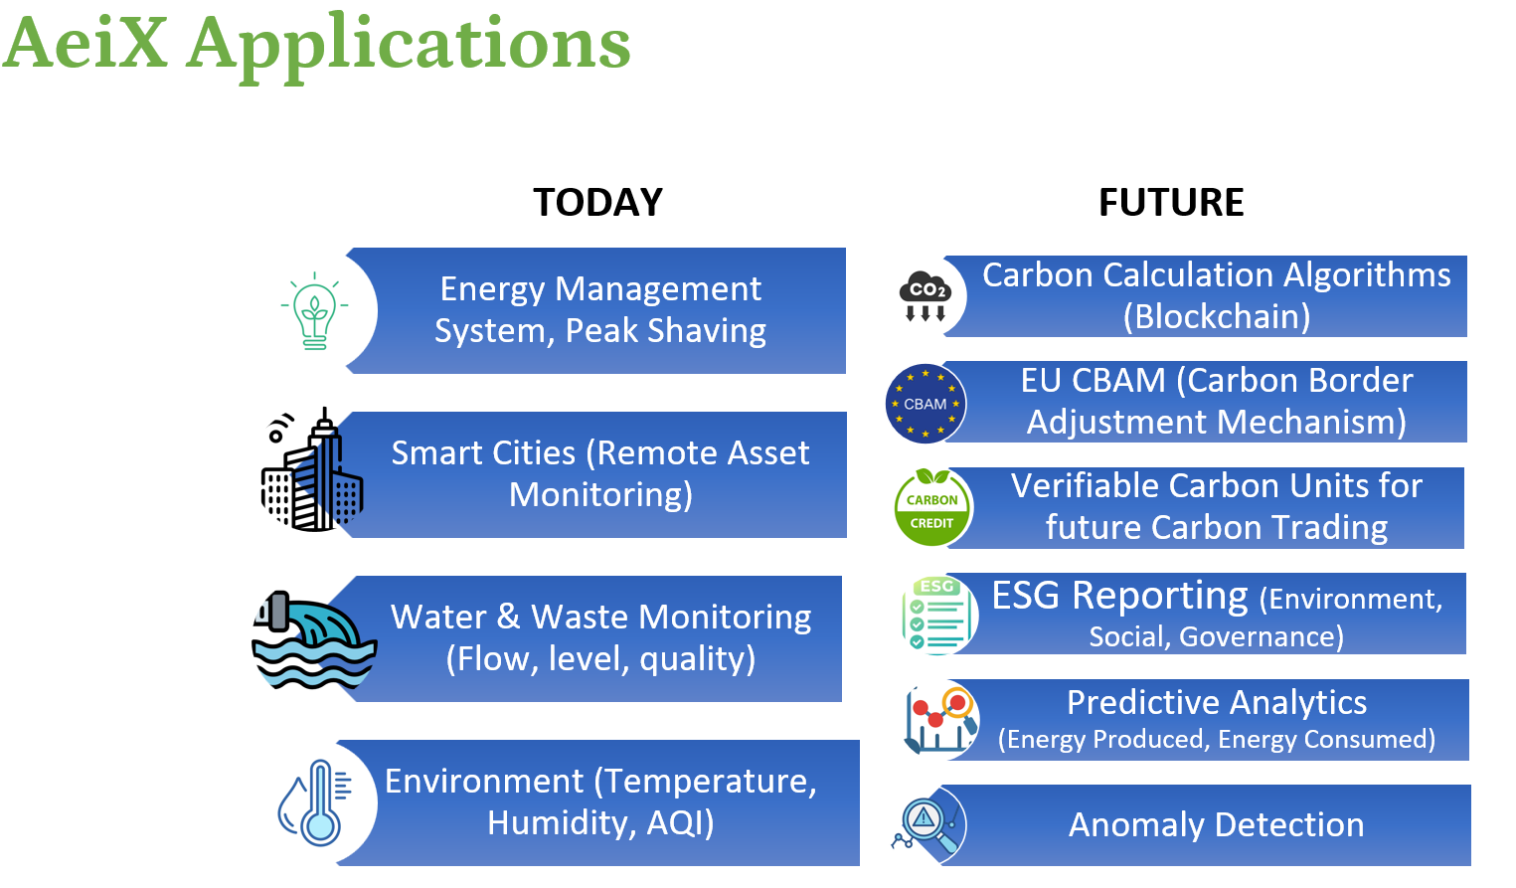

Slide 25
System Benefits
Real-Time Visibility
Comprehensive, immediate insight into energy consumption across all operations. Unify fragmented energy data sources into a single, actionable framework for data-driven decision-making.
Optimized Efficiency
Identify and address inefficiencies dynamically to maximize resource utilization. Transition from manual, outdated data compilation to automated, intelligent system capable of providing accurate, real-time insights.
Carbon Tracking
Enable traceable, immutable carbon-credit verification through blockchain encryption. Calculate carbon emissions, energy efficiency scores, and sustainability compliance indicators for Net-Zero compliance.

Slide 26
Key Takeaways
Real-Time Detection
Scalable Solution
IoT monitoring can detect energy inefficiencies in real time with measurable savings. Comprehensive real-time measurement enables targeted actions improving efficiency and reducing emissions across all operations.
Low-cost ESP32 sensors and Raspberry Pi gateway enable deployment across SMEs and large industries. Affordable, modular architecture makes advanced energy management accessible to organizations of all sizes.
Carbon Verification
Blockchain encryption provides traceable, immutable carbon-credit tracking and verification. Enables transparent sustainability audits, supports Net-Zero compliance, and builds trust in carbon accounting for future sustainable economies.

